Slide 1

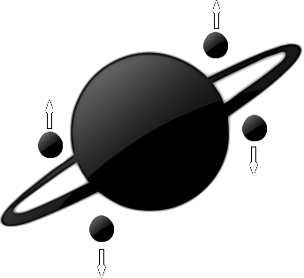

REPorter
Cartaxo Ricardo
Tiago Esteves
Gomes Pedro

Slide 2
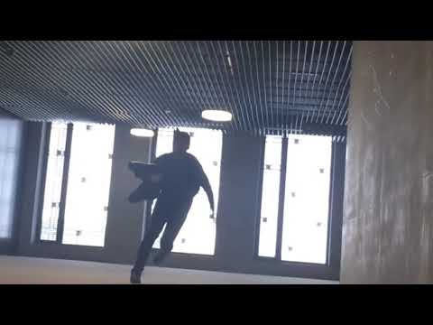
Short video

Slide 3
Index
Entanglement ? How to achieve it ?
Teleportation process. Is it magic ?
How to reliably transport entangled particles ?
Conclusion

Slide 4
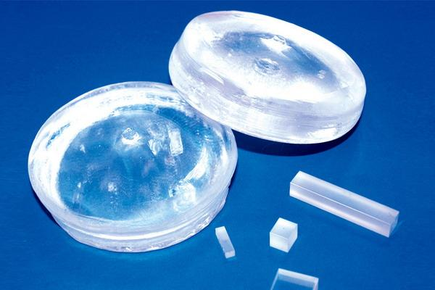
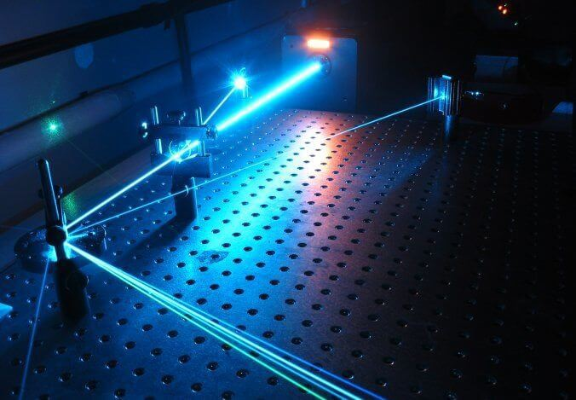
Entanglement ? How is it achieved ?
Entanglement : Two dependently changeable photons.
Rich source of photons + Nonlinear crystal

Slide 5
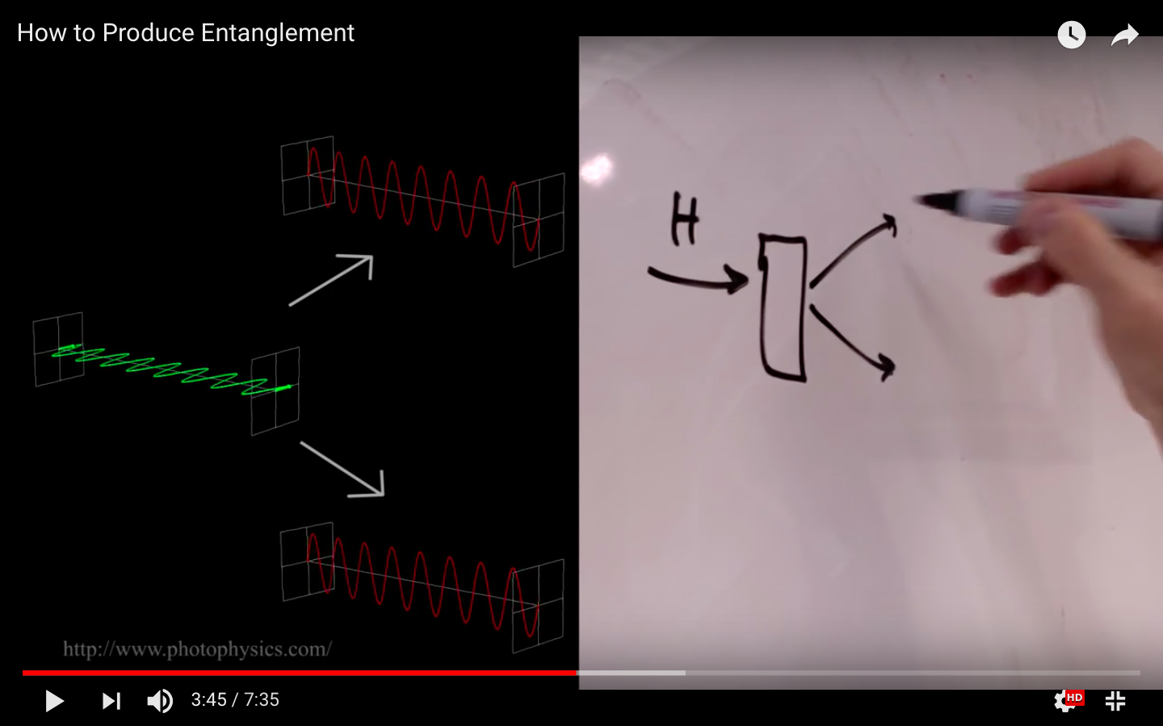
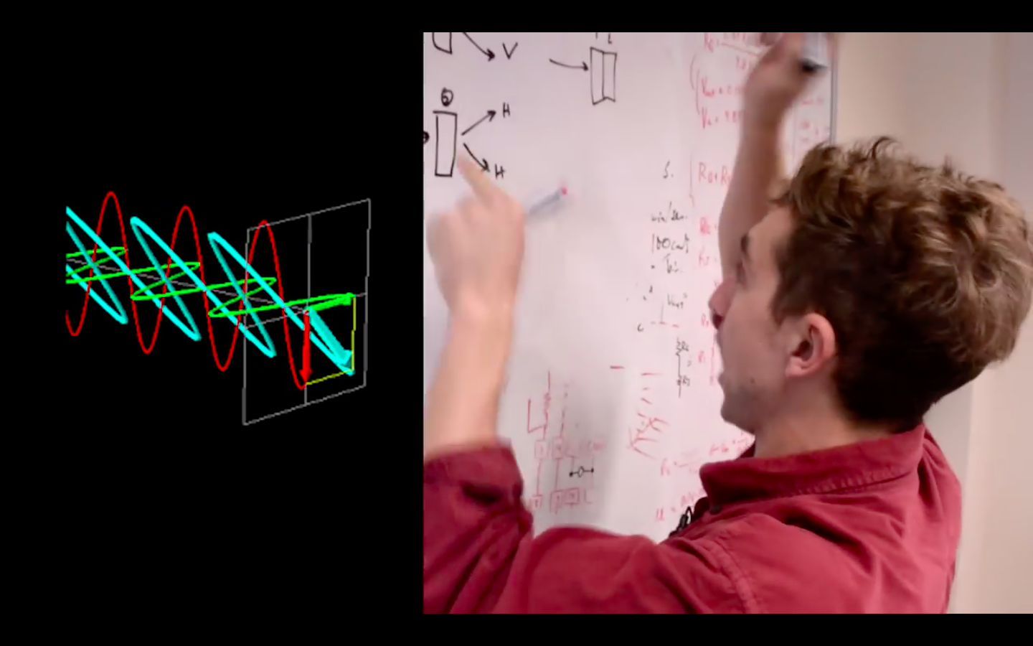
Entanglement ? How is it achieved ?
Horizontal, vertical and diagonal waves.
Input : Horizontal, Output : Vertical
Input : Vertical, Output : Horizontal
Input : Diagonal , Output : Superposition of Horizontal and Vertical

Slide 6
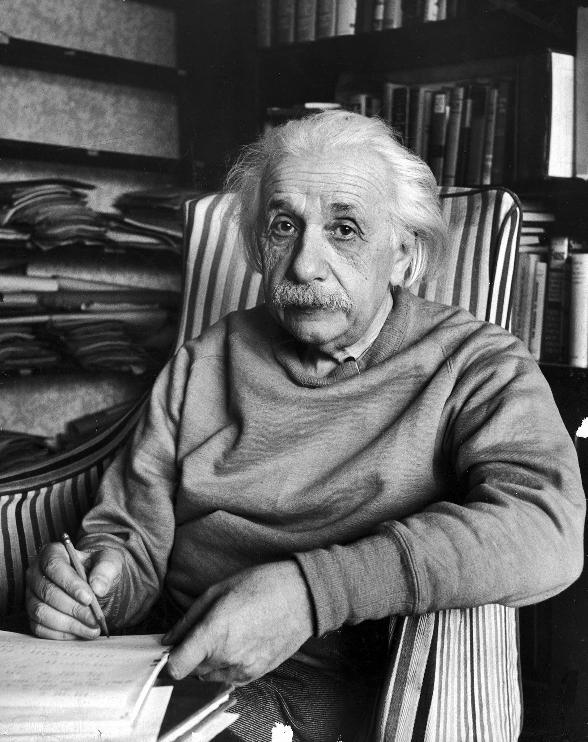
Using Entanglement to our Advantage
" Spooky action at a distance "
- Albert Einstein

Slide 7
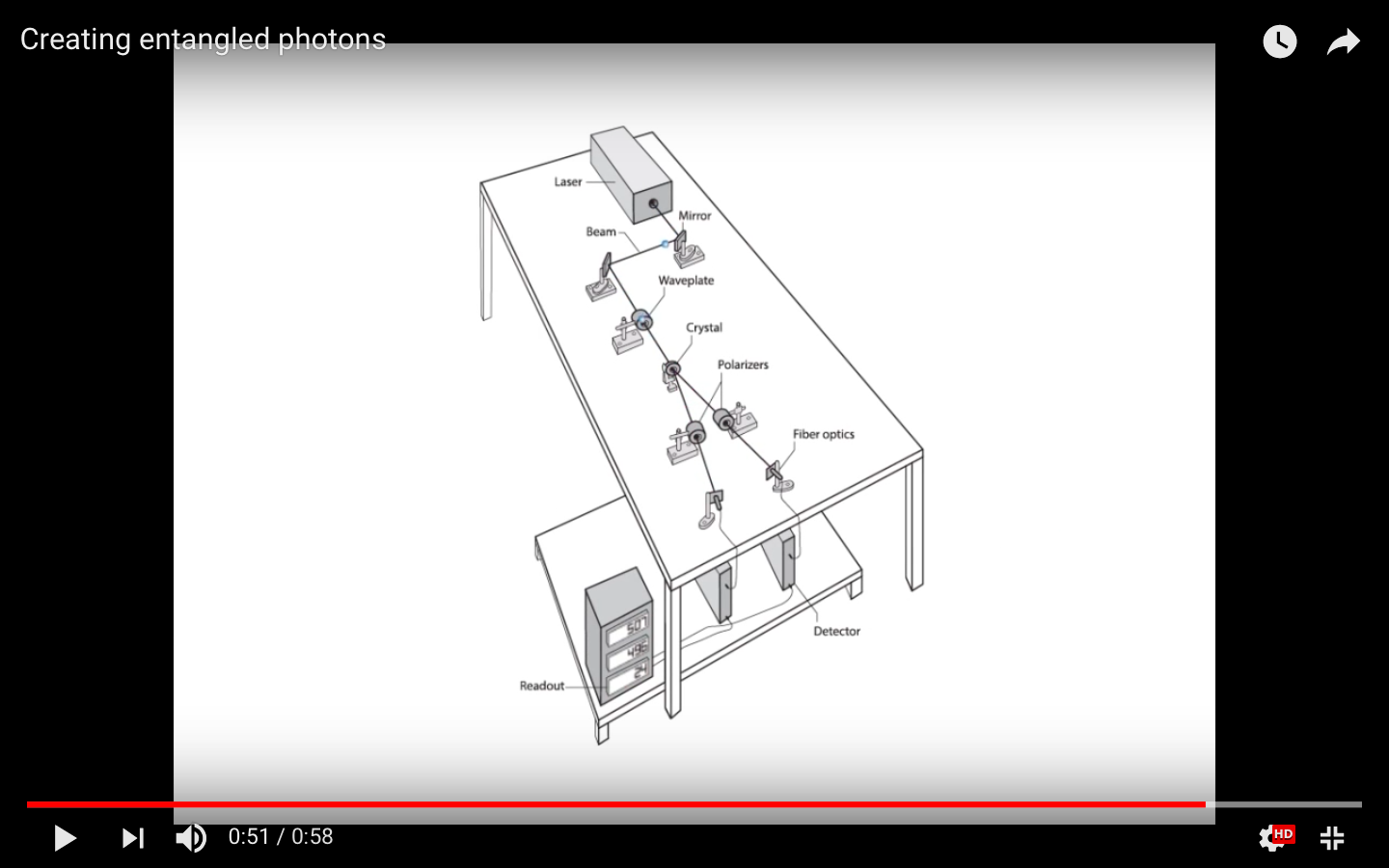

Slide 8
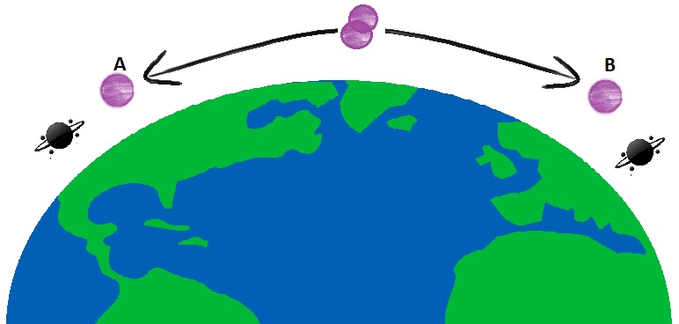
Teleportation Process - Step 1
For each pair of entangled photons:
One is sent to the REPorter at the origin
The other is sent to the REPorter at the destination

Slide 9
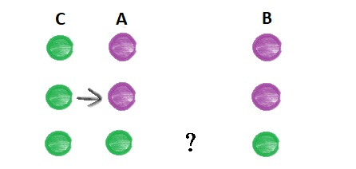
Using Entanglement to our Advantage
What if we copy object C into A?
Measure object C
Change A to resemble C
B changes accordingly

Slide 10
Using Entanglement to our Advantage
It's impossible to reliably measure a quantum object because of 2 quantum physics properties:
Heisenberg's uncertainty principle
A measurement changes the objects quantum system

Slide 11
Teleportation Process - Step 2
Perform a Bell Measurement on A and C
gives vague information about the objects measured
Condition: the entangled pair needs to be in a bell state

Slide 12
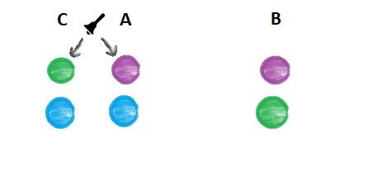
Effects of the Bell Measurement
Objects C and A will become entangled
Measurement will tell us in what bell state C and A are
Quantum states of C and A will change
Change to Object A will influence B
But A and B lose their entanglement

Slide 13
Teleportation Process - Step 3
The result of the bell measurement is transmitted to the destination
Object B becomes identical to the original Object C
Object C is successfully transported to the destination!

Slide 14
How are entangled particles transported between REPorters?

Slide 15
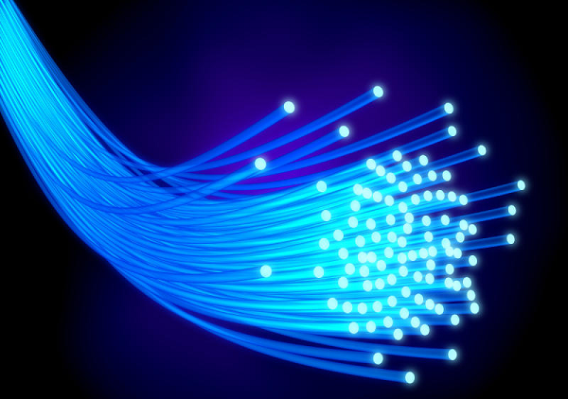
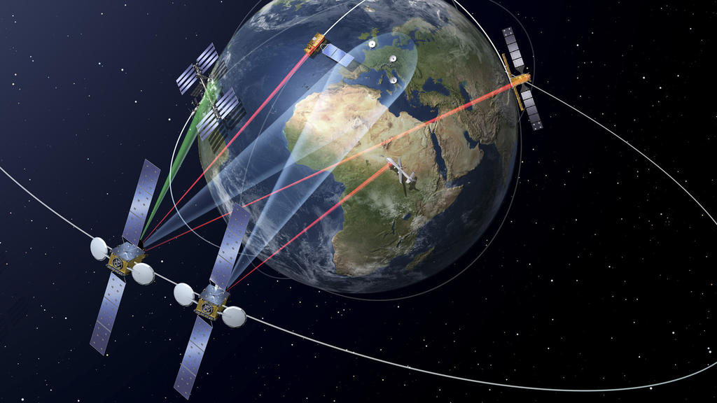
How are entangled particles transported between REPorters?

Slide 16
Possible Destinations
London
Tokyo
New York
Luxemburg
Singapore
California
Rome
Moscow
Moon

Slide 17
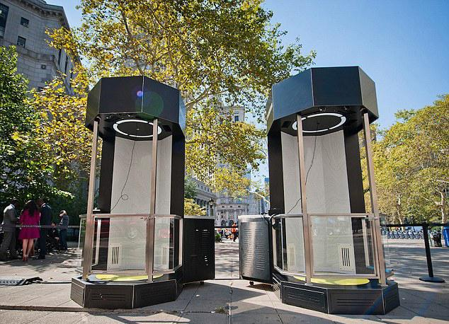
Conclusion

